Slide 1
Data Carpentry Wrap-Up

Slide 2
Thank You!
Thank you all for your hard work!
Big thanks to our instructors, helpers, and workshop organizer!

Slide 3
Workshop Recap
Discussed the dos and don’ts of spreadsheets
Cleaned messy tabular data with filtering, sorting, and faceting in OpenRefine
Wrote SQL queries to select, filter, aggregate, summarize, and join data in relational databases
Wrote code to create and manipulate basic data structures in Python/R
Wrote code to select, filter, aggregate, and summarize tabular data in Python/R
Created data visualizations in Python/R using the principles of the Grammar of Graphics

Slide 4
Where to go from here?
Success is the sum of small efforts, repeated day in and day out.
Robert Collier
Practice ideas:
Your own work at the Smithsonian!
Weekly TidyTuesday Datasets: https://github.com/rfordatascience/tidytuesday
SQL Murder Mystery: https://mystery.knightlab.com/
Automate the Boring Stuff with Python: https://automatetheboringstuff.com/

Slide 5
Smithsonian Data Resources

Slide 6
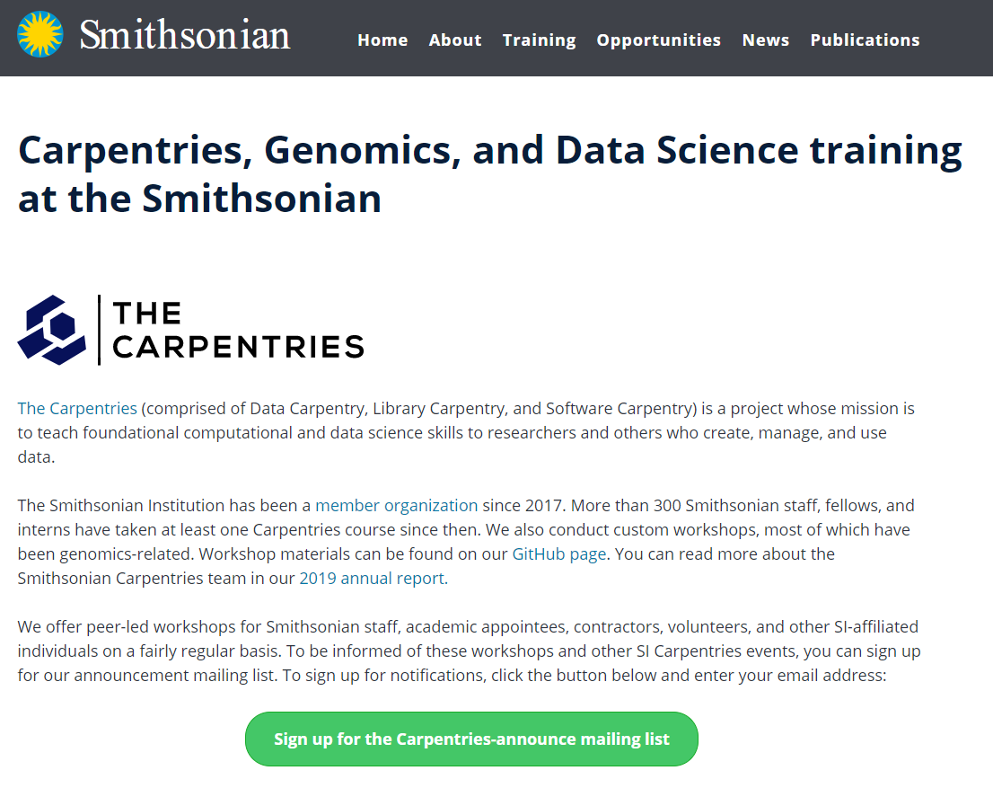
Smithsonian Carpentries Website
https://datascience.si.edu/carpentries

Slide 7
Resource Email Account
For data and/or Carpentries-related questions:
SI-DataScience@si.edu
Feel free to email any of the instructors or helpers directly

Slide 8
Carpentries-Announce Mailing List
For announcements of upcoming SI Carpentries workshops and events:
https://si-listserv.si.edu/cgi-bin/wa?SUBED1=CARPENTRIES-ANNOUNCE&A=1
Sign-up link is also available on the SI Carpentries Website

Slide 9
Carpentries-Alumni Slack Channel
Sign up for the Smithsonian Slack. If you already are a part of the Smithsonian Slack workspace, skip to Step #3. Go to https://smithsonian.slack.com/signup, and enter your SI email account (must be @si.edu).
You will get an email from Slack, and click Confirm Email. This link will send you to a page where you will fill in your name and set a password. After doing this, you will be logged into Slack. You will automatically be added to the #general and #random channels. These channels appear at the top of the list of all channels on the left side, and all others are greyed-out.
In the left-hand sidebar, under the Channels header, you should see an option to + Add channels. Click this link, then select Browse all channels. Search for carpentries-alumni. Click on the channel, then click the Join Channel button.

Slide 10
Carpentries Alumni Microsoft Team
You can access the “Carpentries Alumni” Microsoft Team with this direct link. The “Carpentries Alumni” team is set as a public team, so you should be able to access it via the Teams button on the left sidebar.

Slide 11
SI Carpentries Brown Bag
Monthly lunchtime gatherings to discuss topics relating to Smithsonian Data or Software Carpentry workshop content.
Fourth Thursday of every month from 1pm-2pm ET.
Zoom links provided via Carpentries-Announce mailing list and Slack/Teams channels.
Schedule: https://github.com/SmithsonianWorkshops/carpentries-brown-bag/wiki/Schedule
Archive of past talks: https://github.com/SmithsonianWorkshops/carpentries-brown-bag

Slide 12
Become an Instructor
Apply to join the SI Carpentries Instructor team! We are always looking for Smithsonian staff and fellows to be trained to join our team of instructors.
No prior teaching experience is necessary, but alumni of the Carpentries workshops would make great candidates.
You can apply at:
https://forms.gle/zghh323SJuq1QdKZ8
(This link also exists as a big blue button on the SI Carpentries website.)

Slide 13
The End!
Please keep in touch with us and let us know how you use your new skills!
Are there any questions about the material we covered in this workshop or about Carpentries at the Smithsonian?

